Slide 1

Education 2030 and the SDGS:
Towards a new social contract for future sustainability
How was Education 2030 framed as a multi-stakeholder process?
What might a new social contract for transformative learning look like?
Examples of multi-stakeholder learning initiatives with the SDGs
  Citizen Science (MiniSASS - Online networked learning)
  DoE Curriculum Strategy (E-Cubed - Professional Learning Communities)
  Food Security (Heritage food gardening - Course activated learning network)
Rob O’Donoghue
Environmental Learning Research Centre
Rhodes University

Slide 2
EDUCATION 2030 aims to build a more just and sustainable world by
strengthening ESD to achieve the 17 SDGs through
Nationwide multi-stakeholder initiatives in 5 priority action areas
a) Transformative actions
b) Structural societal change
c) Technology futures
Education 2030 as learning actions to achieve the SDGs requires a switch from education as expert interventions to
multi-stakeholder partnerships

Slide 3

Clarifying a new social contract for Re-imagining our futures together (UNESCO 2021)
﻿”Two vital processes underpin education:
the acquisition of knowledge as part of the common heritage of humanity,
the collective creation of new knowledge and new possible futures.”
                (UNESCO 2021 p. 149)
Pedagogy needs to be expanded around an ethic of cooperation and solidarity.
Pedagogy must foster empathy and compassion in work together to transform ourselves and our world.
Learning develops through co-engaged relationships between teachers, students, and available knowledge.
Learning extends student relationships and an ethic of care and shared responsibility within a common world.
Pedagogy activates transformative learning encounters around realities that exist and can be built together. (p.147)

Slide 4
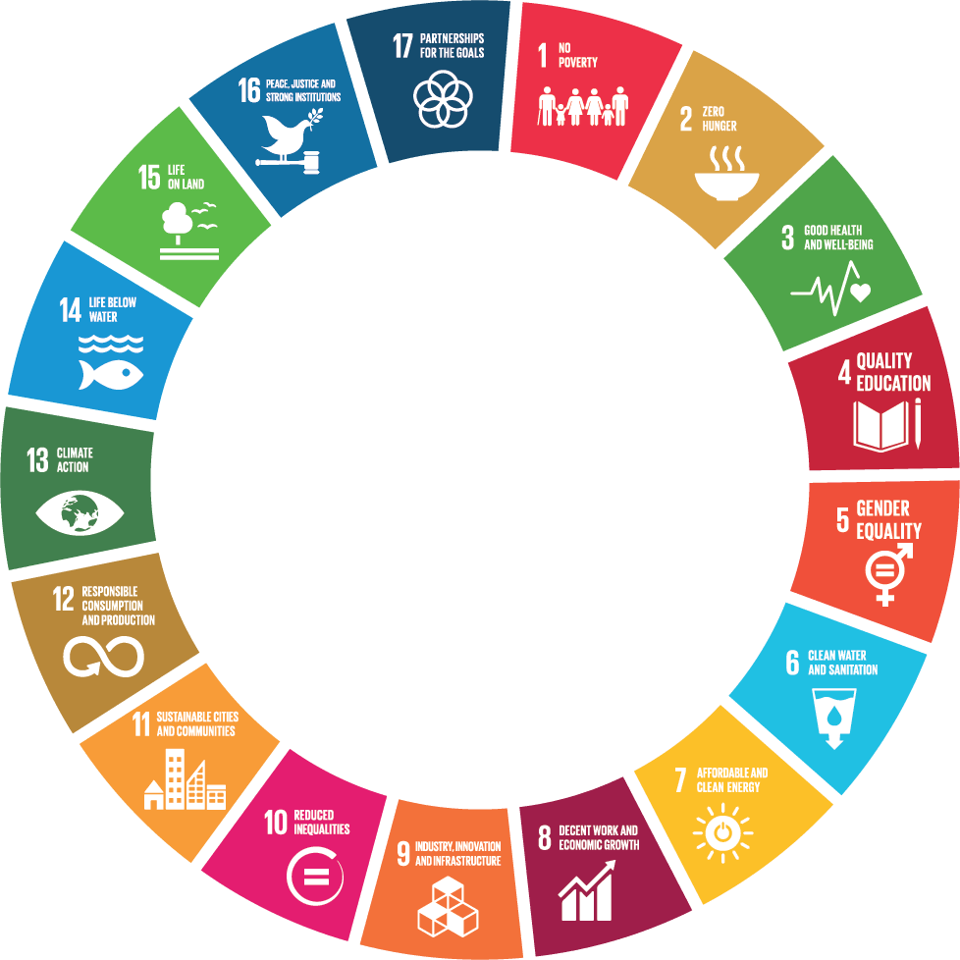
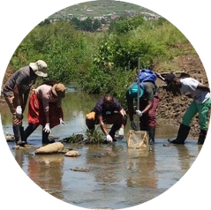
1. A new social contract for community-engaged action learning through Citizen Science
Global
Partnerships
Peace &
Justice
Poverty
Description of our context: Mpopomeni stream being tested by youth to assess water quality and risk to Midmar Dam water supply for Durban & Pietermaritzburg.
Our concerns driving ethical purpose: Overflow from sewage manhole covers increasing disease risk and entering the stream to pollute Midmar Dam
Summary of our current knowledge: Groups have been monitoring manhole outflow, reporting blockages and educating community members.
Learning-led change proposed: Water quality and sewage problems are reported to municipalities who are funding the expansion of the blockage monitoring and reporting services.
CURRICULUM CONTEXTS
Hunger
Subject knowledge
MiniSASS inquiry
Life on
Land
Health & Wellbeing
Q1
Q2
Life in
Water
Q4
Q3
Change Challenges
SDG
analysis
Education
Matter of
concern
COMMUNITY CONTEXTS
Climate
Co-engaged action learning networks for regenerative lifestyle / livelihood transformation
Gender
Production &
Consumption
Water
Cities
Energy
Inequality
Decent Work
Economy

Slide 5

2. One Country – One Goal:
Reducing youth unemployment and poverty by 90% by 2035.
Our theory of desired change statement is:
IF: all SA teachers are motivated and skilled to teach using Active Learning Pedagogies and are supported by systems and ecosystems inside and outside the DBE (SDG 4);
AND 100% of learners / youth thereby are engaged in meaningful, relevant schooling that activates solution-seeking mindsets and 21st century competencies (SDGs:1; 4; & 5);
SO THAT 100% of learners / youth are prepared for life after school by engaging in further learning, employment, and/or starting their own enterprises (SDGs: 8 – 13);
THEN the unsustainably high levels of
youth unemployment and poverty will
decrease by 90% by 2030 (SDGs: 1; 2; 8; 10 & 11).

Slide 6
2. Education Sector Plan
Mandated by Human Resources Development Council (HRDC)
Blueprint accepted by DoE 2018
Lekgotla EiS becomes E³
^{2018 Pre-pilot phase}
^{2019 – 2021} ^{Pilot Phase}
^{2022 – 2024} ^{All schools}
^{2025 – 2030} ^{Strengthening}
2018
Pre-pilot
2019 to 2021
Pilot
2022-2024
All schools
2025 to
2030
support
Curriculum strategy

Slide 7

3. Food Security: SDGs informing a heritage gardening learning network
Global
Partnerships
Peace &
Justice
Poverty
Description of context:
Seasonal droughts and social grants to alleviate poverty.
Hunger
Life on
Land
Concerns driving ethical purpose:
40% decline in rural household food production. Develop an ‘each-one teach-one’ learning network for water-wise heritage gardening.
Health & Wellbeing
Life in
Water
Education
Matter of
concern
Summary of current knowledge:
Students and staff at an agricultural college develop a knowledge map for a learning garden for practical work and community engaged action learning.
Climate
Gender
Production &
Consumption
Learning-led change:
The short course activated social learning network on heritage food production, water harvesting and water-wise food gardening.
Water
Cities
Energy
Inequality
Decent Work
Economy

Slide 8
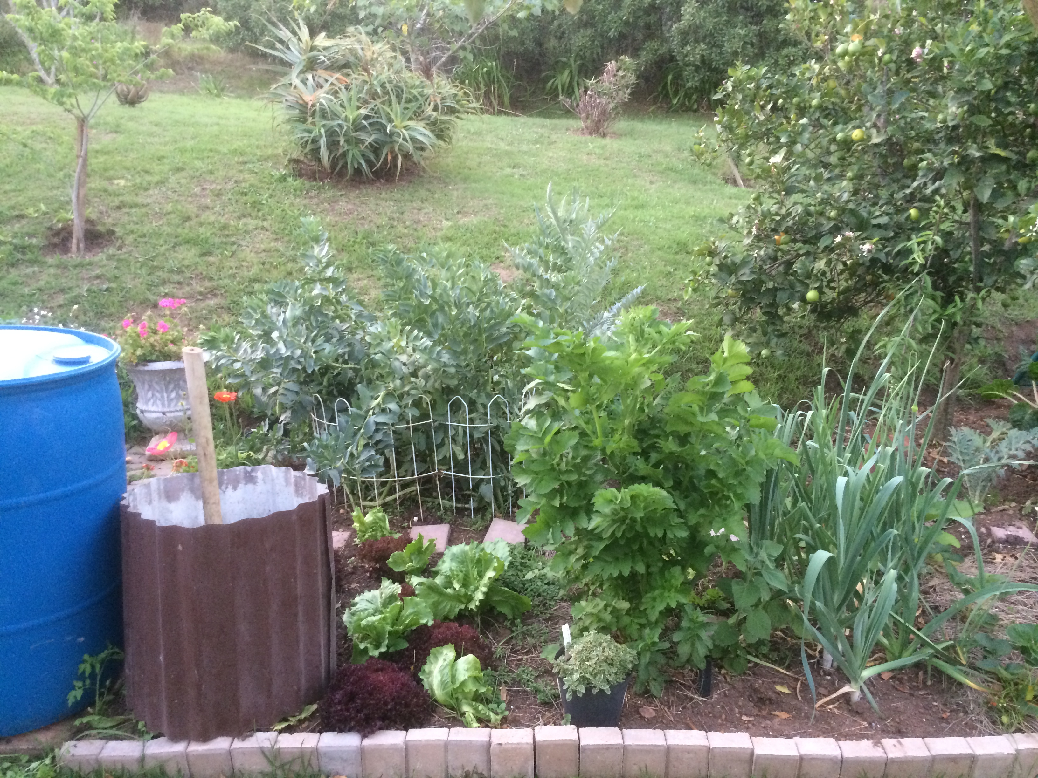
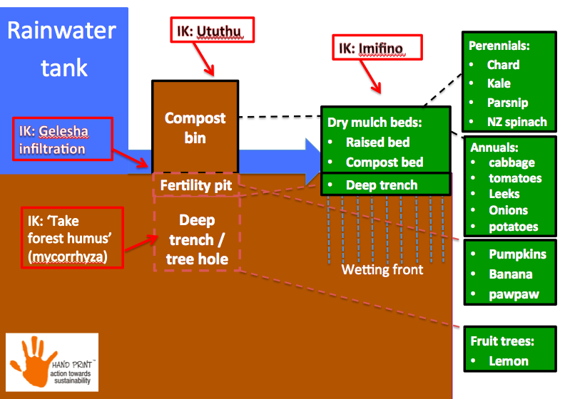
3. Course Activated Social Learning Network:
Heritage Gardening Practices
Water
Capture, store and clean water better
Waste
Refuse, reduce and re-use waste better
Gardening
Grow leaf-picking vegetables at low cost.
Biodiversity
Plant trees that provide food and seasonal benefits.
Healthy Lifestyle and Livelihoods
Make health giving broth, bread, jam and greens at low cost.
Heritage
Food Garden

Slide 9

HERITAGE FOOD GARDEN
Starting Points
HG4
Imifino
HG3
Galesha
HG5
Umhlaba
HG2
Izala
HG1
SDG Concerns
https://www.youtube.com/channel/UCtJI_qWsmtRJzwugEAIlWTw/videos

Slide 10
References:
O’Donoghue, R.B. Taylor, R.J. and Venter, V. (2018) How are Learning and Training Environments Transforming with ESD? In Education on the Move, Chapter 5 pages. 111-132. Paris, UNESCO.
O’Donoghue, R.B. and Roncevic, K. (2018) ﻿Theorien lernbasiertem Wandels in der Bildung für Nachhaltige Entwicklung Paradigmenwechsel weg vom dominanten Bildungsverständnis. Zeitschrift für internationale Bildungsforschung und Entwicklungspädagogik 43. Jahrgang 2020, Heft 1, S. 20–26 doi.org/10.31244/zep.2020.01.04
O’Donoghue, R., Henze, C., Shimray, C., Sarabhai, K., and Sandoval Rivera, J.C. (2020) Hand-Print CARE: Towards ethics-led action learning for ESD in school subject disciplines. Ahmedabad, Centre for Environmental Education. Journal of Education for Sustainable Development.
UNESCO (2021) Reimagining our Futures Together:
A new social contract for education. Paris, UNESCO.

